Slide 1


Çankaya University
Engineering Faculty
Department of Computer Engineering
FRIENDLY GAS
Group Members
Sertan Umut Gürel
Atakan Göknar
Atakan Taner Gül
Tonguç Berat Özel
Supervisor: DR. Faris Serdar Taşel

Slide 2
1
INTRODUCTION OF THE PROJECT
2
MAIN FEATURES
3
SIMILAR WORKS
4
MAIN CONTRIBUTION
GENERAL USE CASE
LOCATION USE CASE
FILTER USE CASE
ADMIN USE CASE
LOGIN USE CASE
FAQ USE CASE
PRESENTATION OF CONTENTS
5
TOOLs
6
CLASS DIAGRAM
7
ACTIVITY DIAGRAM
8
PROJECT OVERVIEW
HOME PAGE
NEAREST GAS PAGE
FAQ PAGE
9
FUTURE WORKS

Slide 3
INTRODUCTION OF THE PROJECT
Our project is a gas related website. Gas is one of the most used things in our age and our point is for the people who use it it can be quite beneficial for their personal economy if they use our project.

Slide 4
MAIN FEATURES
Finding the nearest and cheapest gas station
Benefiting people's economies
Helping people save time
Providing free access

Slide 5
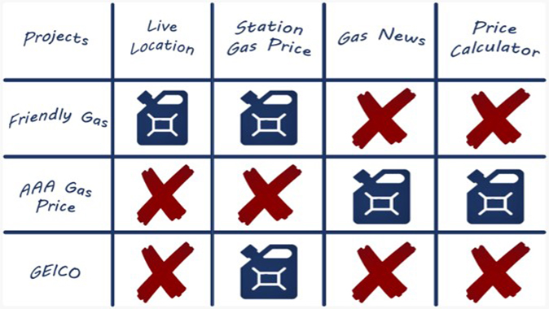
SIMILAR WORKS

Slide 6
MAIN CONTRIBUTION
This part contains general use case, location use case, filter use case, admin use case, login use case and FAQ use case .

Slide 7
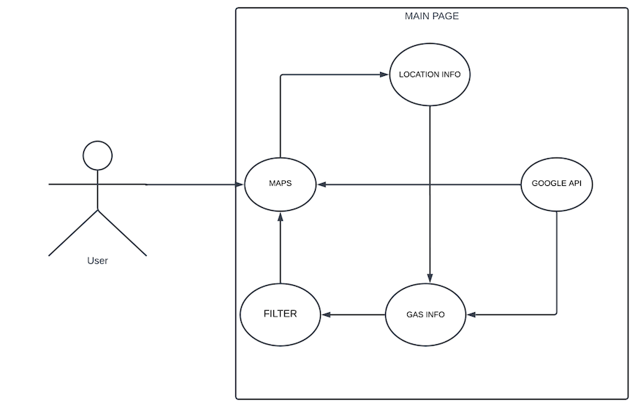
GENERAL USE CASE
MAIN CONTRIBUTION
General Use Case explains how our system works in general.

Slide 8
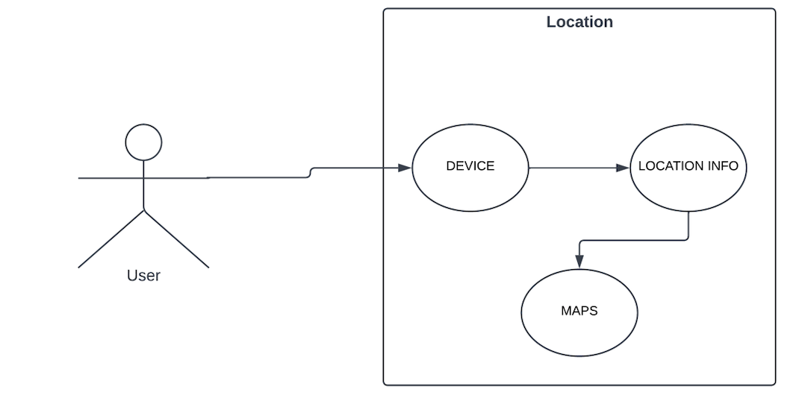
LOCATION USE CASE
MAIN CONTRIBUTION
Location Use Case shows how the location system works.

Slide 9
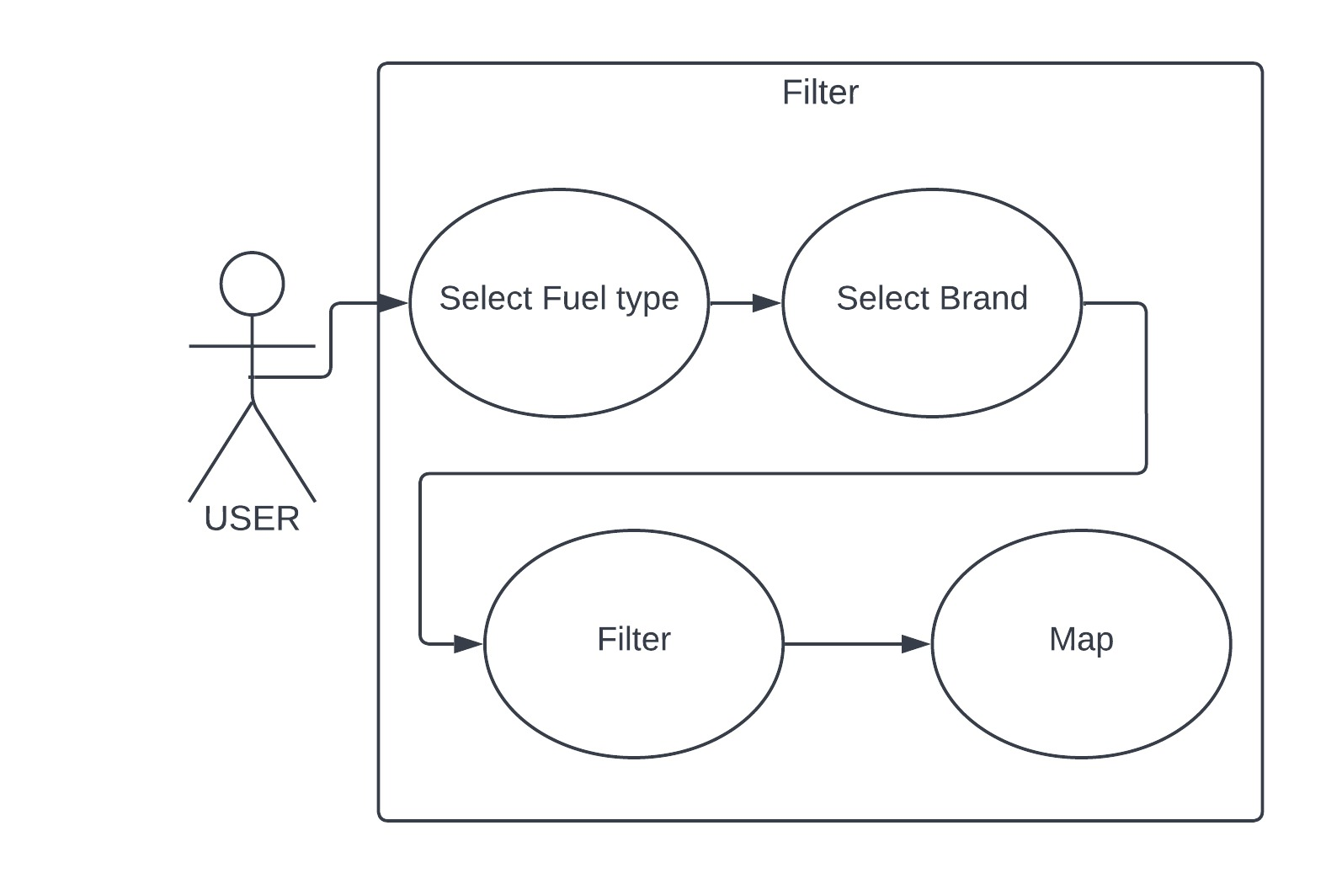
FILTER USE CASE
MAIN CONTRIBUTION
Filter Use Case shows how the filter system works.

Slide 10
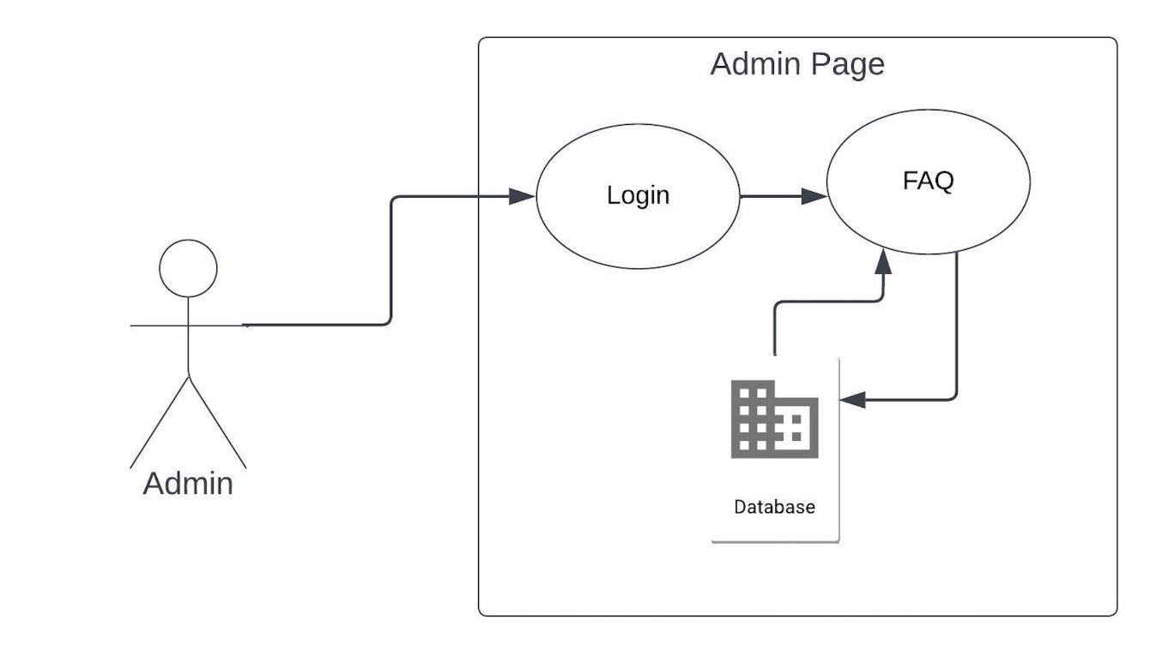
ADMIN USE CASE
MAIN CONTRIBUTION
Admin Use Case shows how the manage FAQ page.

Slide 11
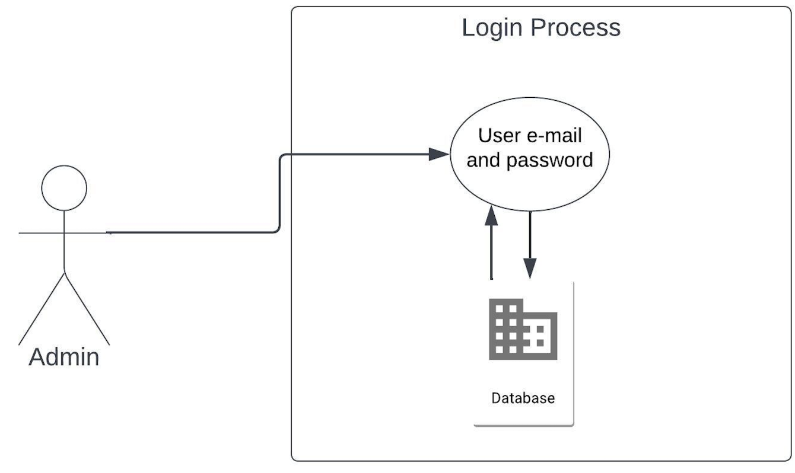
LOGIN USE CASE
MAIN CONTRIBUTION
Login Use Case shows how to admin login admin page.

Slide 12
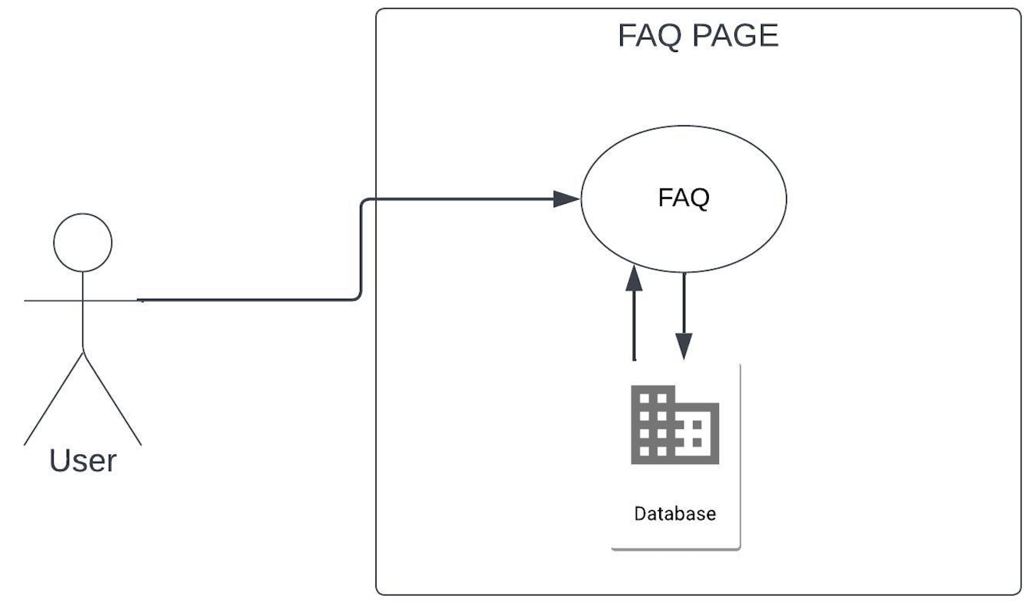
FAQ USE CASE
MAIN CONTRIBUTION
FAQ Use Case shows how to FAQ page works.

Slide 13





TOOLS
PhP
JavaScript
Sql Server Management
HTML
CSS

Slide 14
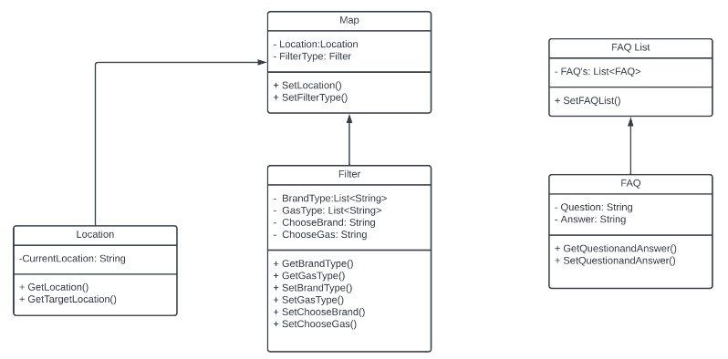
CLASS DIAGRAM

Slide 15
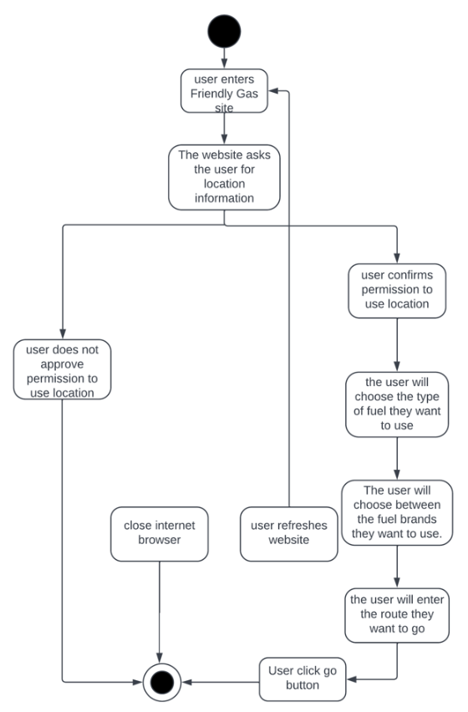
ACTIVITY DIAGRAM

Slide 16
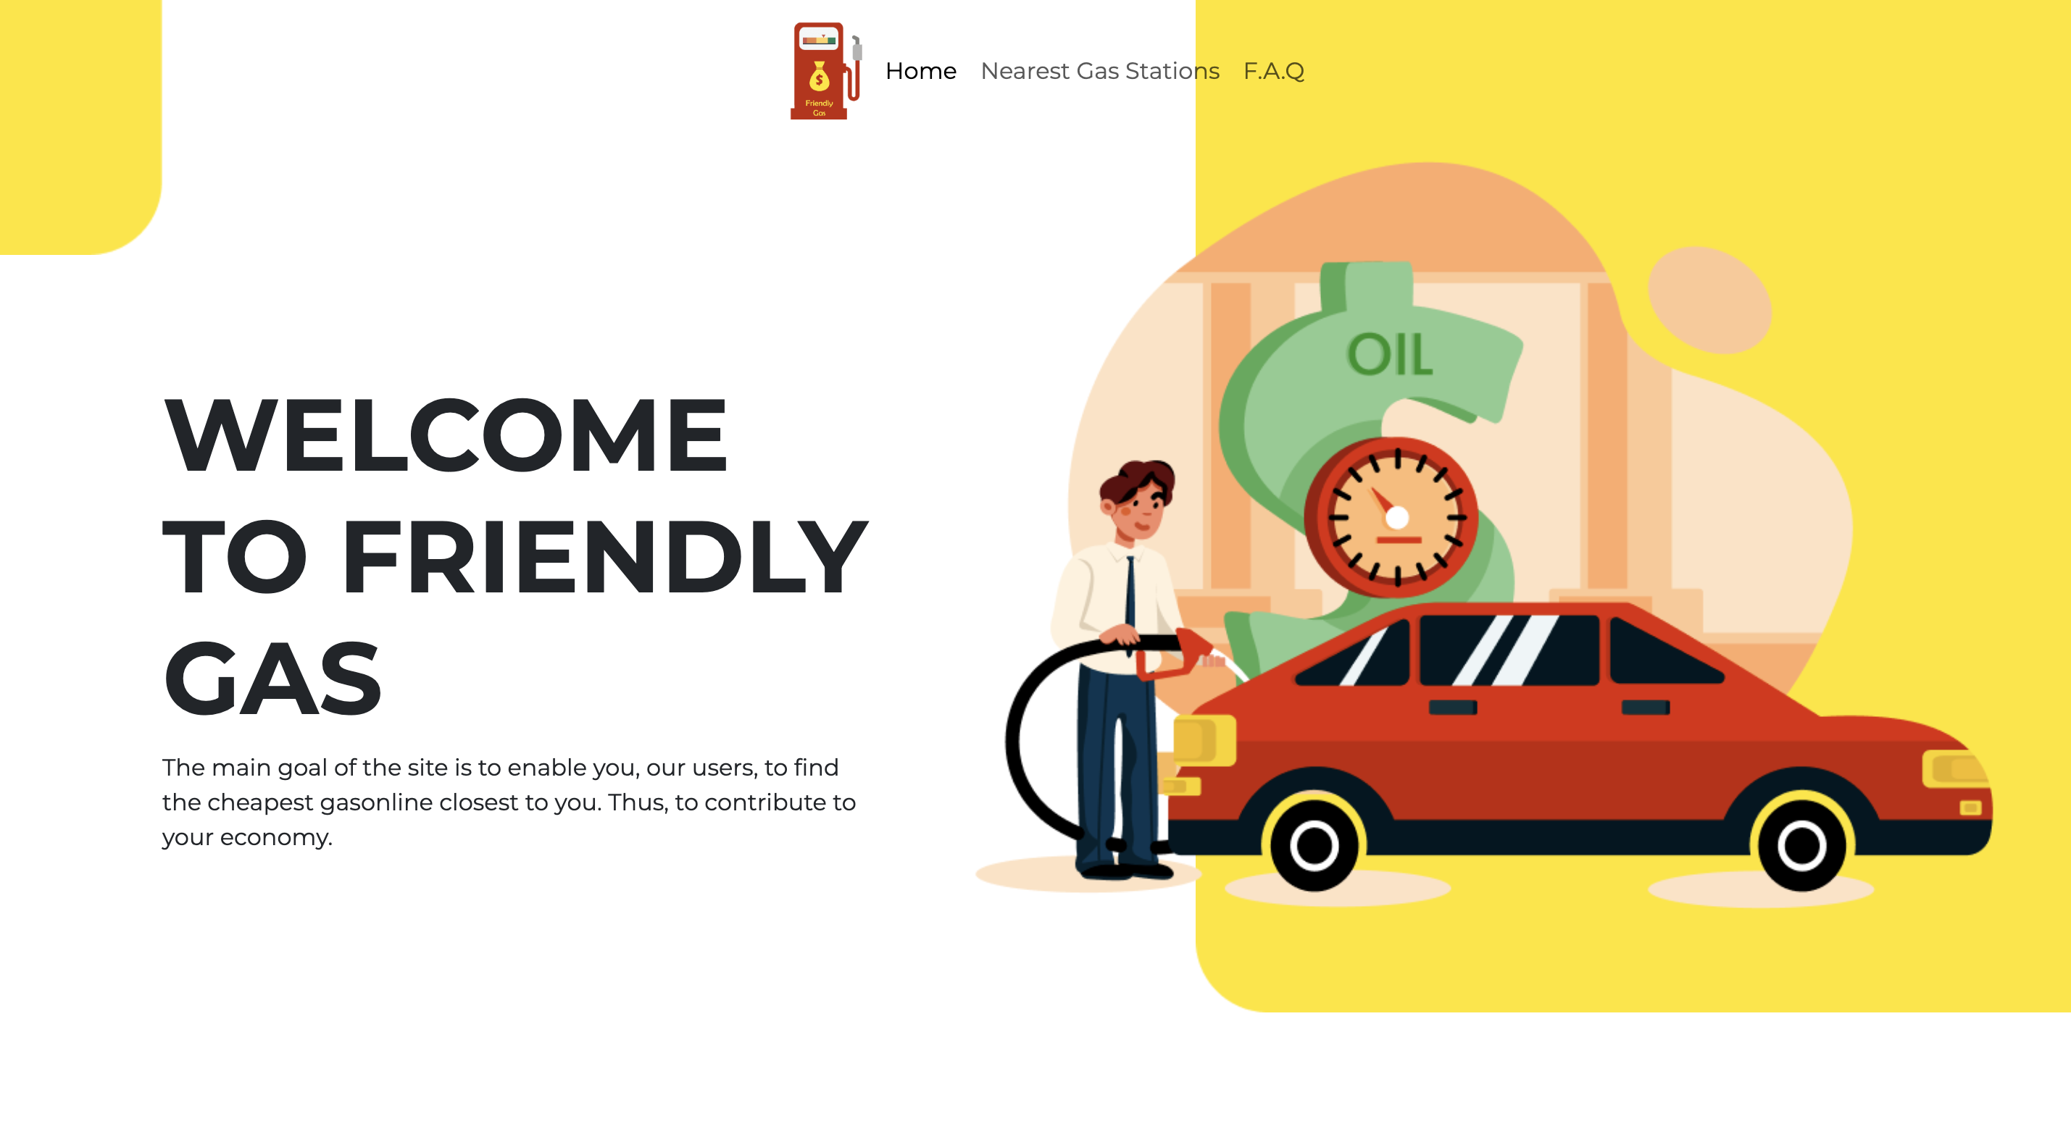
HOME PAGE
PROJECT OVERVIEW

Slide 17
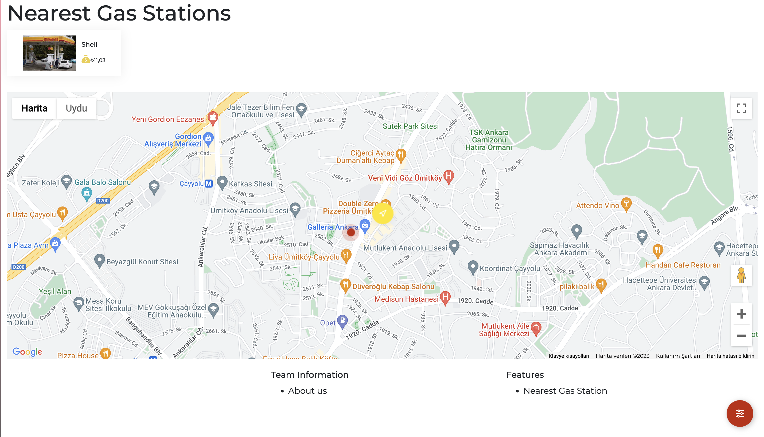
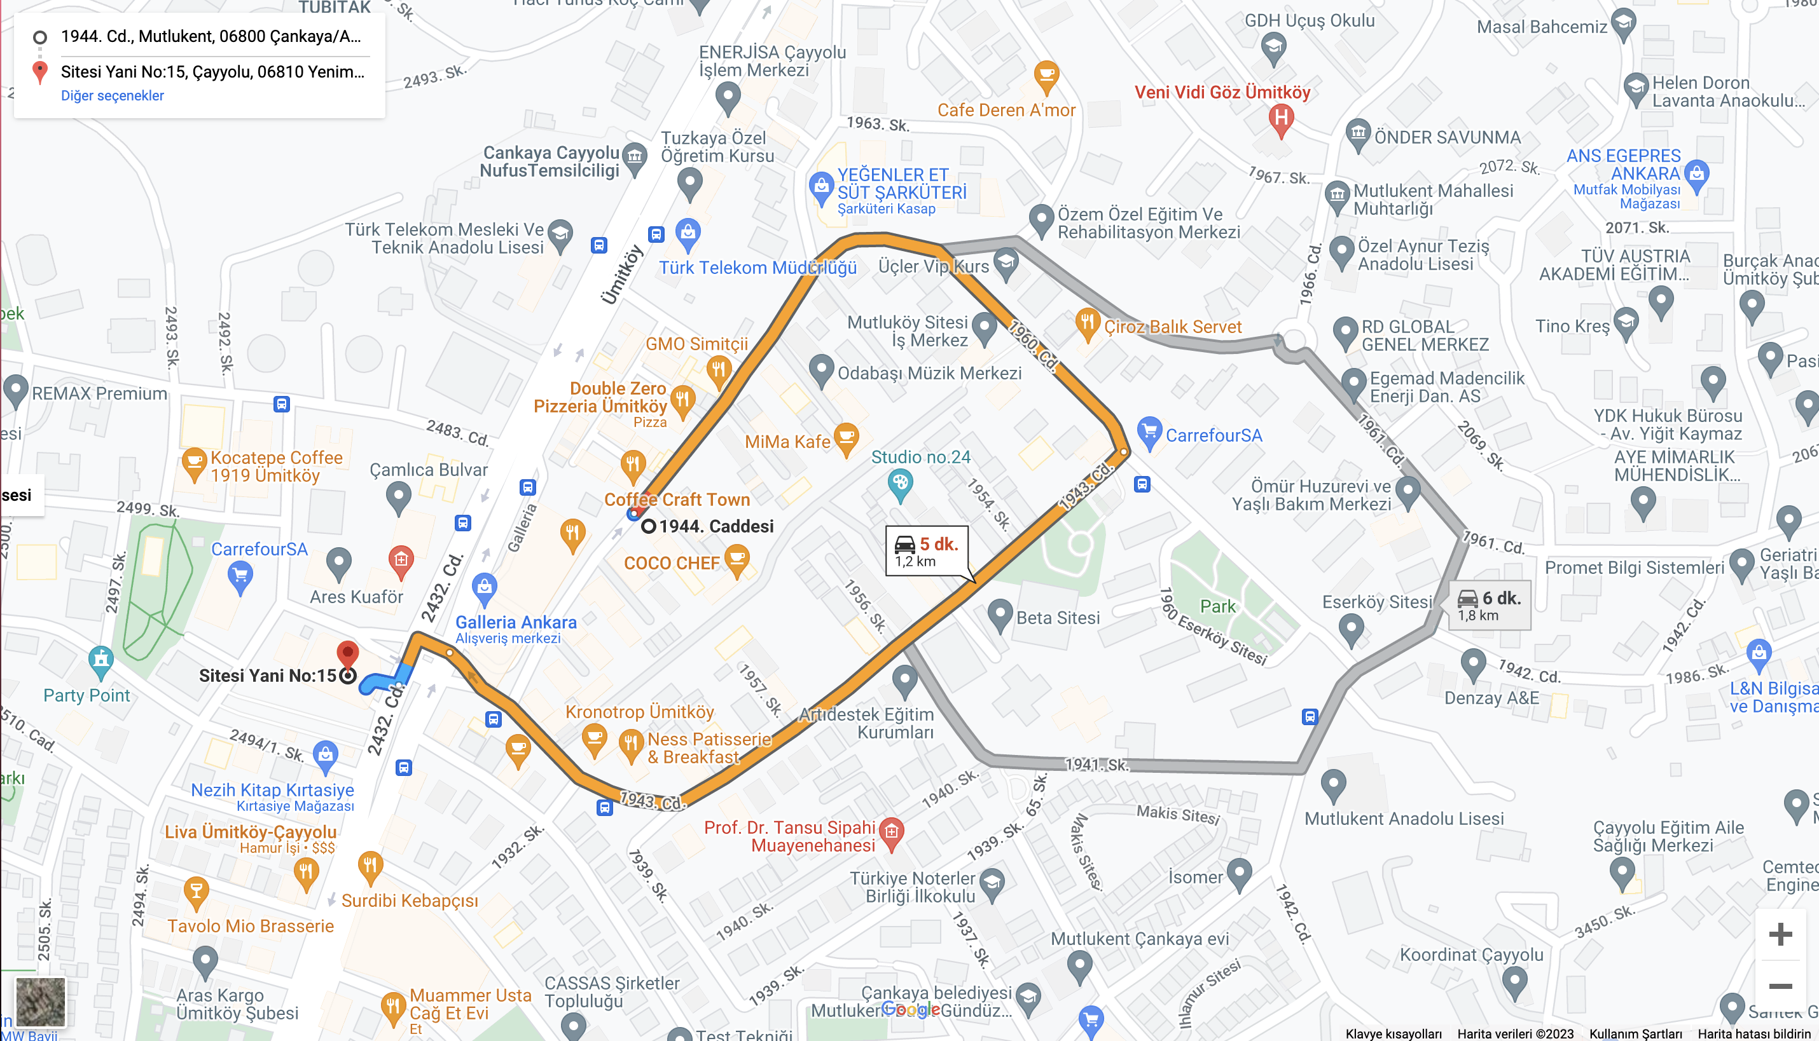
NEAREST GAS PAGE
PROJECT OVERVIEW

Slide 18
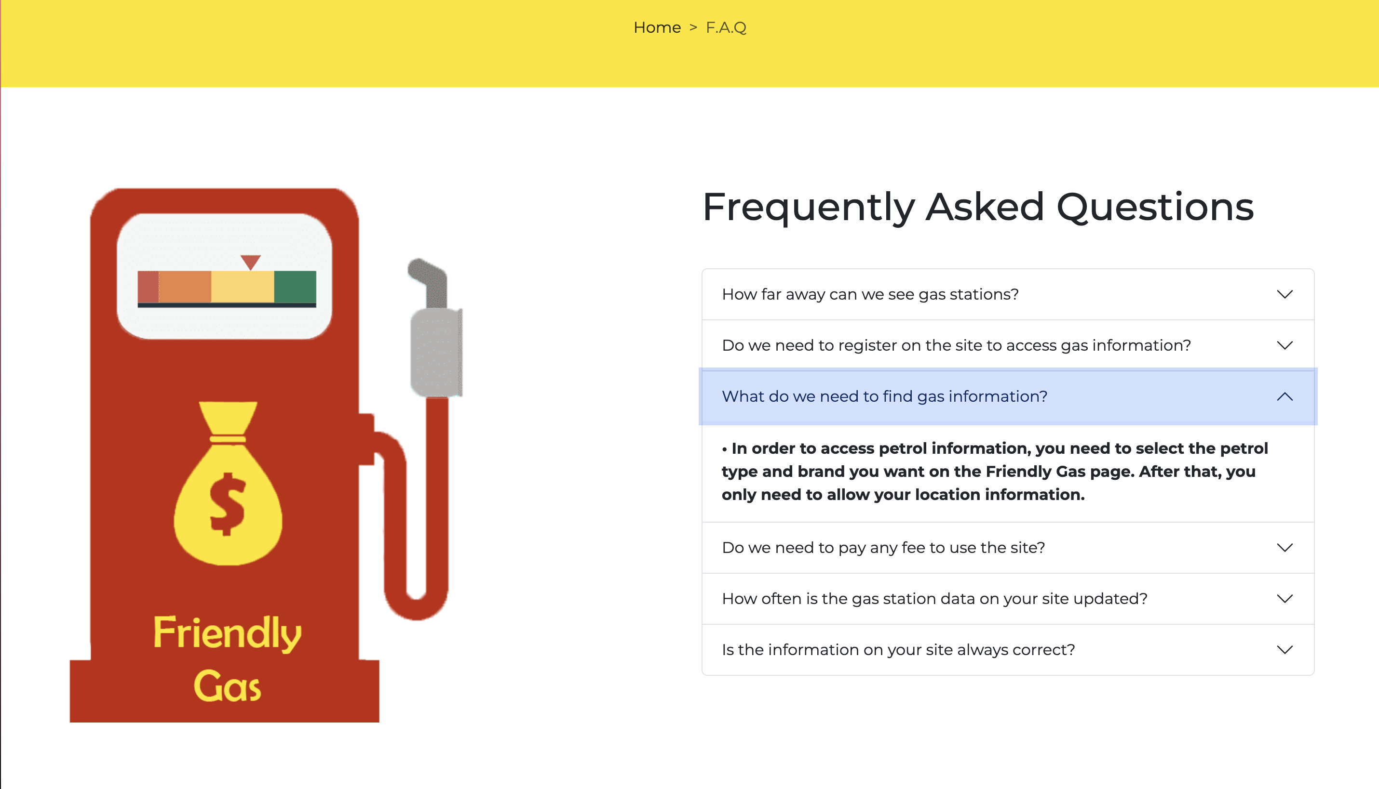
FAQ PAGE
PROJECT OVERVIEW

Slide 19
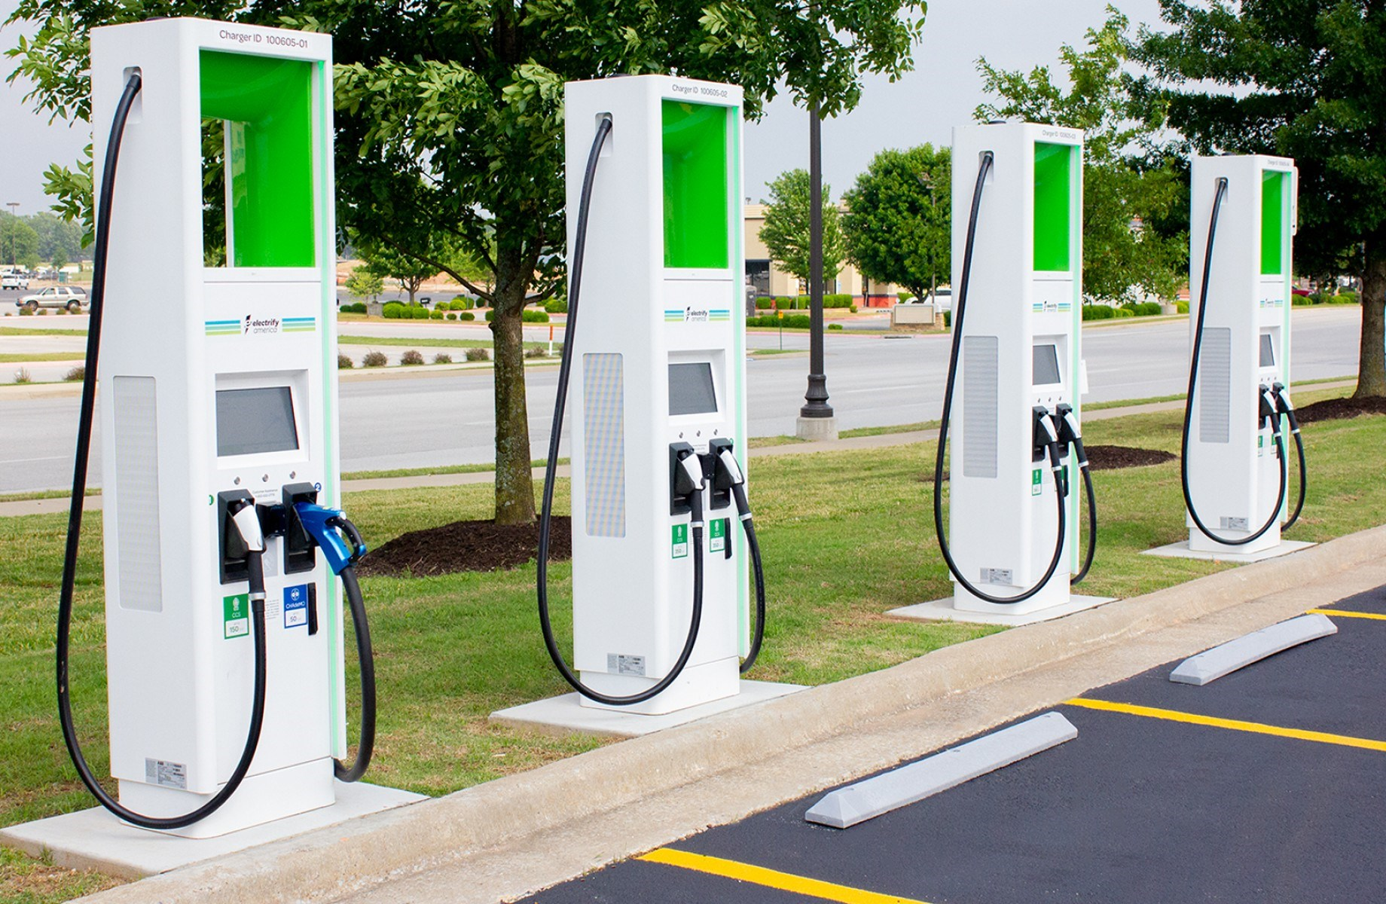
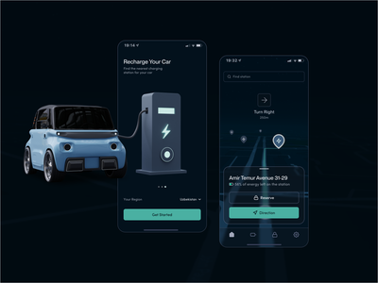
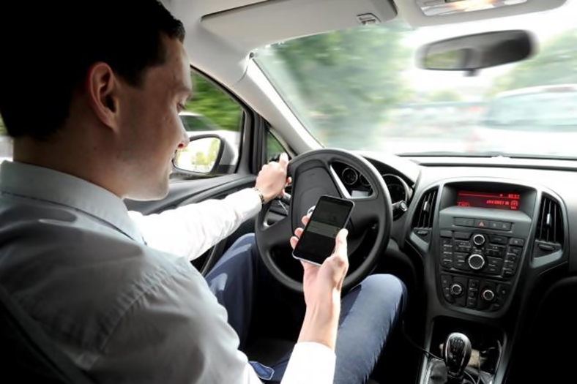
FUTURE WORKS

Slide 20
Any Questions ?
Thanks For Listening Us

